Slide 1
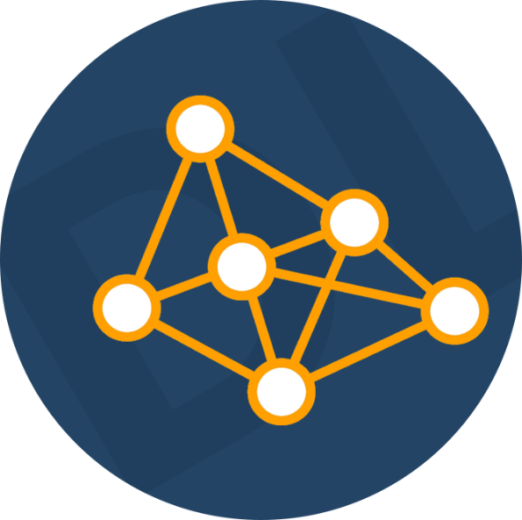
Course Introduction
What (and how) are we going to learn?
Yordan Darakchiev
Technical Trainer
iordan93@gmail.com

Slide 2
sli.do
#DeepLearning

Slide 3
Table of Contents
Course objectives
Prerequisites
Curriculum
Course schedule
Trainer
Lecture format
Final exam
Some learning resources

Slide 4
Course Objectives
Achieving state-of-the art results
by learning like a human

Slide 5
Course Objectives
Learn how neural networks are used in the real world
Get insights on structuring a deep learning algorithm
  Architecture
  Hyperparameters
  Troubleshooting and debugging
Learn how to manage a deep learning project
  E.g. utilizing big data, error analysis, project roadmap
Learn various concepts related to deep learning tasks
  E.g. images, text, spatial data, audio, playing games, generation
Explore and use popular architectures
Do at least one complete project

Slide 6
Prerequisites
Intermediate English
Programming Basics
Maths and Machine Learning
Knowing the foundations of machine learning is required
Understand what is written on the slides
Scientific Mindset
Be open to (and not afraid of) challenges
Software development experience is a plus
Some algebra, calculus and statistics
Familiarity with Python is required
Know how to work with data

Slide 7
Course Format Details
Curriculum, schedule, trainer,
lecture format, exam

Slide 8
Curriculum
Introduction to deep learning. Basic models
Training and improving neural networks
Image-related neural networks
Natural language processing
Neural network architectures
Generative models
Reinforcement learning
Exam preparation: end-to-end project
Course / module summary: Q & A

Slide 9
Course Schedule
Lessons
  9 lectures x ~ 3 hours each on-site
Homework: 0+ hours
  You're on your own!
  Try reading papers
    Even scientific articles
  Try out different possibilities
    Architectures, models, model compositions, loss functions, etc.
Extracurricular activities: 0+ hours
Practical exam
  Preparation at home – 10+ hours
  On-site defense: 10-15 minutes

Slide 10
Final Exam
Quiz (theoretical exam)
  10 questions for 30 minutes
Practical project
  Work on your own
    No teams allowed
  Present your results (documentation, code, models,
  Web services, etc.) in a limited amount of time
Work on a given assignment
  Perform research
    Scientific papers, community forums, etc.
  Analyze the data
  Choose or create an architecture
    Perform several iterations of modelling
    Document all your findings
  Communicate the results
  Optionally… do whatever you like :D

Slide 11
Grading Scheme
Quiz: 20%
Final exam: 80%
  Develop at your own pace
  Upload deadline: 19 February 2021, 12:00:00 GMT+2
  On-site defense: 21 February 2021, 09:00:00 GMT+2
  Retake: 28 February 2021, 09:00:00 GMT+2
Forum / Facebook group activity
  Bonus up to 20%

Slide 12

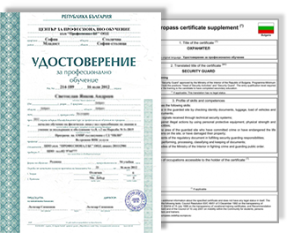
Grading and Course Certificates
All students will be graded on a scale from 2,00 to 6,00
  The same way the standard grading in Bulgaria works
Everyone who scores ≥ 5,00 (total) on the course
will get a certificate from SoftUni
  Starting point for a new career
  or continuing education in your current field
  Career assistance
    The SoftUni career center will help you find work
  Official and recognizable
    Employers value certificates
  Proof of hard work :)
    Shareable and verifiable
Everyone who scores $≥$ 3,00 (total;
theory + practice) can get a MoES certificate
as well

Slide 13




Programmer
  .NET / full-stack Web developer
Machine learning engineer
  Multiple projects, mainly image processing
Trainer
  Various programming courses
  Scientific (and popular) lectures
Scientist / Enthusiast
  BSc (July 2016), MSc (February 2018)
  in Astrophysics
  Currently pursuing a PhD
Machine
learning
Research
Teaching
Software
engineering
Python
C#
JavaScript

Slide 14
Learning Resources
Learn more
and share your knowledge

Slide 15
SoftUni Course Pages
Official Web page of this course
  https://softuni.bg/trainings/2781/deep-learning-december-2020
Forum category
  Open courses > Deep Learning
  Ask and answer questions
    I will try to answer your questions as well
  Post what you've learned
    Links to resources, code snippets, ideas, tips and tricks
  Share your problems (homework or not) and help solve them
  Create and maintain a community
    A critical part of software development and science
Facebook group
  https://www.facebook.com/groups/DeepLearningDecember2020/

Slide 16
Online Resources
Books
  "How not to be wrong" – Jordan Ellenberg
  Deep Learning – Ian Goodfellow
  … and anything else you can find
Websites
  Communities: Kaggle, Quora, Stack Exchange
  Online courses: Coursera, edX, MIT OCW, Stanford, etc.
  "Big players": Microsoft, Google, Facebook, Amazon, IBM, Apple, etc.
YouTube
  FunFunFunction, Daniel Shiffman, AsapSCIENCE, Veritasium,
  Vsauce, TedEd, CrashCourse, Mind Your Decisions, Infinite Series, Numberphile, Computerphile, Vi Hart, 3Blue1Brown,
  blackpenredpen, Mathologer, and many more

